Slide 1
SENG2260 Human-Computer Interaction
Week 5: Affective Aspects & International User Interfaces
All images in this presentation are either licenced or labelled for reuse on Google Images.

Slide 2
Lecture Aims
To consider user interface design in a global context
Describe three levels of interface specification to support internationalisation
Define cultural factors and multi-cultural interface design
Explore interface localisation and support for user-oriented interface customisation

Slide 3
The issues
Factors that effect an individual’s response to a system
Age, gender, race, sexuality, class, religion and political persuasion
Exported software frequently requires modifications to suit:
local customs,
laws,
or conventions

Slide 4

The issues²
Most experiences have concentrated on the technical issues
such the spelling dictionary
However some applications blend technical and social facilities such as groupware
This increases the complexity of the design issues
The development of multiple interfaces is costly
It is important to make generic, and easily modifiable, as much of the interface as possible

Slide 5
Three levels of interface specialisation
Three levels of specialization
Globalisation
applying an allegedly cultureless standard
Internationalisation
designing base structures with the intent of later customisation
Localization
developing specific interfaces to meet a particular market

Slide 6
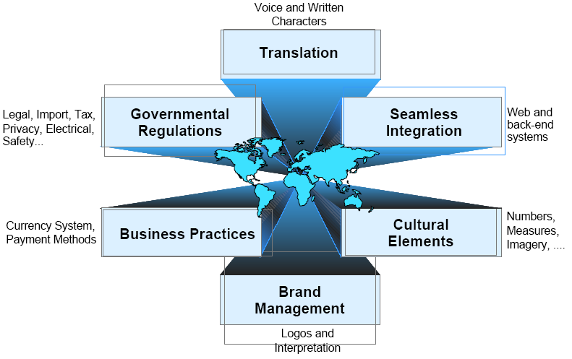
Localisation

Slide 7
Effective design
Effective design involves recognizing the cultural elements in a given application
Cultural diversity makes it even more unrealistic for designers to rely on intuition or personal experience for interface design
Adaptation of shared interfaces requires identification of user factors, including:
Objective factors: gender, age, ethnic background, mother-tongue.
Subjective factors: which cannot be directly measured or identified such as cognitive style

Slide 8
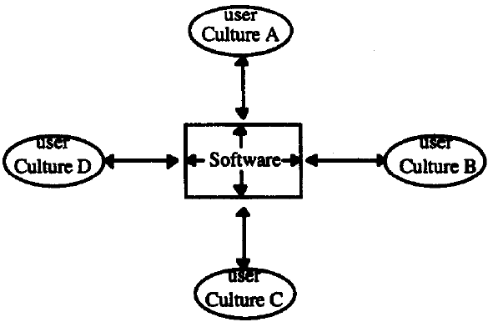
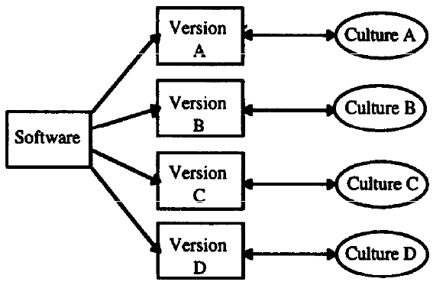
Who are you designing for?

Slide 9
Approaches
Adoption of a user-centred development approach, whereby users and developers can work together on the identification of factors which effect usability and which specify performance
Effective use of iterative and parallel prototyping, so as to facilitate user participation and maximise the effectiveness of the interface evaluation process whilst minimising the time required for development
Integration of Taguchi techniques; thereby providing the rigour necessary for identification of the optimum interface
Minimising variation as the main means of improving quality
Systematic and logical integration of techniques, so that the method can be applied by commercial interface designers

Slide 10

Cultural factors
Cultures could be reviewed through four dimensions
Power distance: the degree of dependence between boss and subordinate
Collectivism-individualism: integration into cohesive groups vs. being expected to look after him/her-self
Femininity-masculinity: the extent to which gender roles are distinct or overlap
Uncertainty avoidance: the extent to which members feel threatened by uncertain unknown situations
(Based on the work of Hofstede)

Slide 11
Cultural meta models
A culture model helps to identify levels of issues being involved in this complex problem by using international variables or dimensions of culture
International variables are categories that organize cultural data
Cultural meta models that help us to understand how and where culture comes to influence our lives in a profound way
These models tell us that:
culture has multiple layers and what we can normally observe is only the most external layer which counts for about 10% of its total influence.

Slide 12
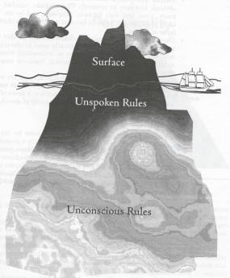
Iceberg model
Only 10 percent of the cultural characteristics of a target audience is “easily” visible to an observer
Surface: visible, obvious rules such as number, currency, time and date formats
Unspoken rules: obscured, need context of situation to understand the rules
Unconscious rules: rules out of conscious awareness and difficult to study

Slide 13
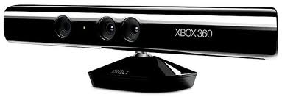
Multi-cultural interface design
Del Galdo (1990) gives practical advice on factors that are affected by culture, language and local conventions:
Character sets and collating sequences
Format conventions for numbers dates, times, currency
Layout conventions e.g. for addresses and telephone numbers
Icons, symbols, and colours; screen text
Menu accelerators e.g. using initial letter of verbs

Slide 14
Culture, language and local conventions
Character sets
e.g. the Latin alphabet, the Arabic and Hebrew character systems
Collating sequences
these define the value and position of each character with respect to other characters.
Alphabetic and alphanumeric lists are sorted according to these sequences.
However, different cultures have different sequences and rules for sorting these characters
Numeric formats
e.g. decimal fractions can be separated by periods or commas

Slide 15
Culture, language and local conventions²
Data formats
these can vary for example in the way each component - month, day and year - is separated (by comma, period or space), in the sequence in which components are presented,
or in the length of month names, according to each language
1/11/11 11.1.11 2011 11 1 1.11.11
1st November 2011, November 01 ’11
Currency formats
for example, currency symbols can be placed before or after the numerical value depending on local convention
US$200, 400EUR

Slide 16


Culture, language and local conventions³
Time formats -time can be displayed differently (e.g. in some places the 24 hour clock notation is used while in others the 12 hour notation is more common)
9.30pm 2130hr
Telephone numbers -these can vary in length and in the way they are separated (with commas or parentheses)
Icons and symbols

Slide 17



Nielson identifies the following problems
Only 13% of Japanese identified first aid from the Red Cross logo
Mail boxes are different across countries, especially colours
Italics used for emphasis cannot be used in all forms of written language, i.e Japanese (have to be replaced by shaded box
X = not wanted in some countries
So this is a problem:  Greyscale (meaning reversed)

Slide 18
Culture, language and local conventions³
Time formats -time can be displayed differently (e.g. in some places the 24 hour clock notation is used while in others the 12 hour notation is more common)
9.30pm 2130hr
Telephone numbers -these can vary in length and in the way they are separated (with commas or parentheses)
Icons and symbols
Colour - colours have different connotations in different cultures

Slide 19
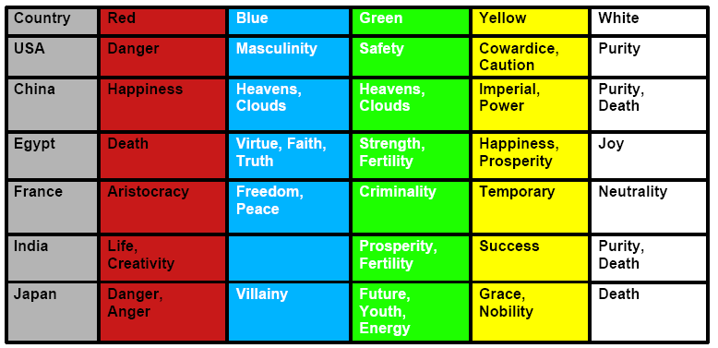
Colour danger
Be prepared to change colours

Slide 20
Culture, language and local conventions⁴
Screen text
the use of abbreviations, acronyms or jargon, the use of “over-friendly writing style”,
the use of culturally specific examples,
the length of the text,
and the use of references to religious, national or racial stereotypes
Menu accelerators and documentation
mnemonic accelerators cause problems because they are based on the first letter of the command.
When the commands are translated, there might be a situation in which two commands begin with the same letter.
This can confuse the user

Slide 21
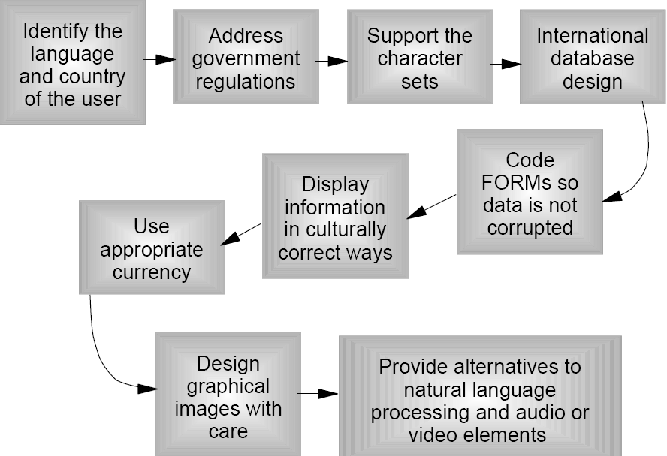
Design considerations

Slide 22
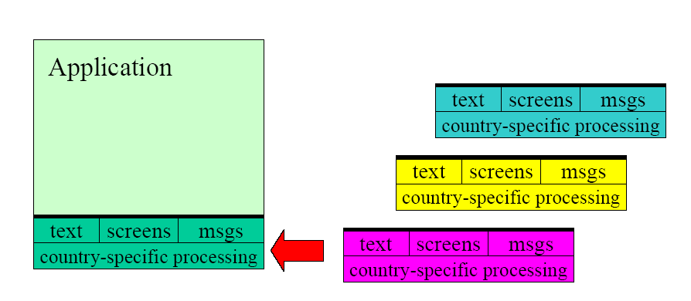
Single application localisation
Handle multiple languages, i.e. within the same application
Universal text encoding using Unicode
Consistent but localised user interface

Slide 23
Things to avoid
Don’t
Hard code text in source code
Refer to culture specific standards
Use slang, jargon, humour, sarcasm, colloquialism, metaphors
Difficult to translate, require an understanding of originating culture
Form plurals by adding “(s)” to indicate either singular or plural form.
Use both forms if necessary

Slide 24

User customisation
Keep sentences as short and simple as possible
Allow users to select the date and time format
Allow users to select calendar format
Allow users to select paper size
Allow users to select numeric and monetary formats

Slide 25
You should now...
Be able to define what UI localization is
Be able to explain how HCI design can support multi-cultural user interfaces
Be able to define user interface examples of culture, language and local conventions
Be able to describe the design workflow for international user interfaces

